Slide 1
Environment: protect or destroy?

Slide 2
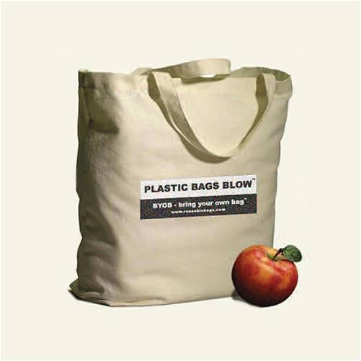

Save the environment
In Mornico’s supermarket we use cloth bags

Slide 3
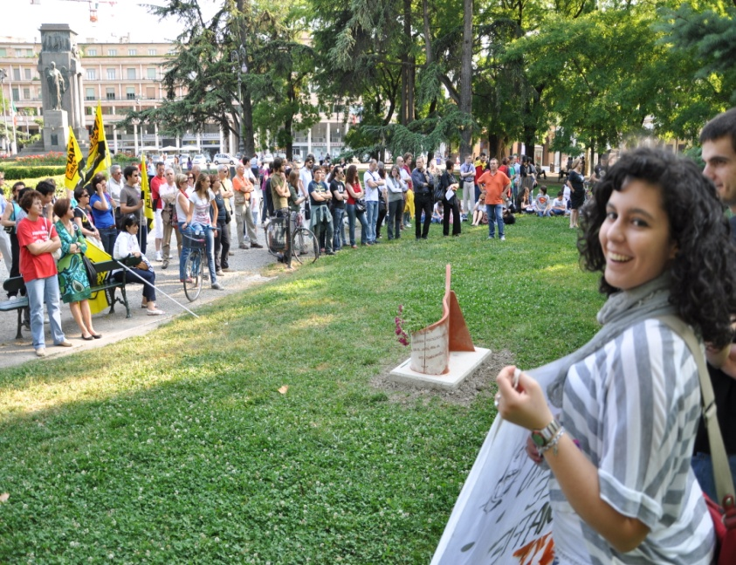
What do we do in our town to take care of the planet
We help the environment a lot, in fact, every year we go to clean up the town with the fire brigade, we divide tasks , we use bags and gloves to collect rubbish.

Slide 4
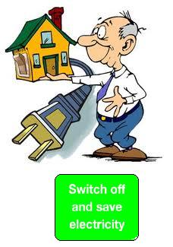
Save Electricity
In my village the electricity is always used 24/7. In my opinion it would be nice to save electricity. People should use less electricity, turn off the lights at night in houses and in the streets.

Slide 5
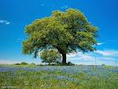
Work to save our town
In Mornico, our town, I do social work to help.
I try not to use the heaters too much because it’s polluting.
I turn on the fireplace when it's warm.
We also try to pollute less going on foot instead of by car .

Slide 6
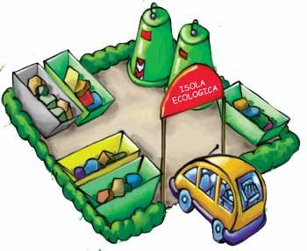
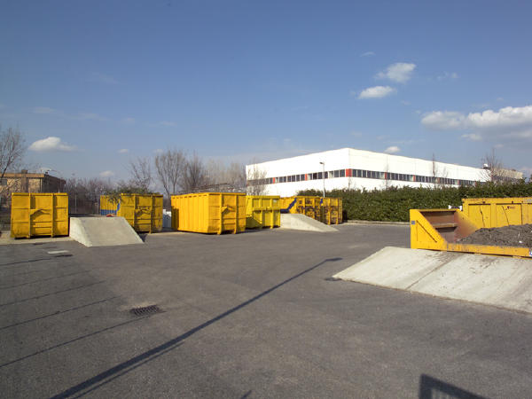
Green pitch
In our country there is a recycling station and it’s really big.
People do not want to throw the garbage everywhere.
Our recycling zone is very tidy.
Rubbish is divided in various areas according to their kind.

Slide 7
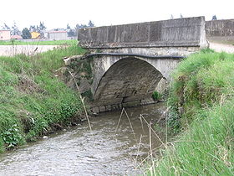
The river banks
Once a month in Mornico there is a machine to clean the banks of the river Zerra.
It goes along the river and cleans the dirt.

Slide 8
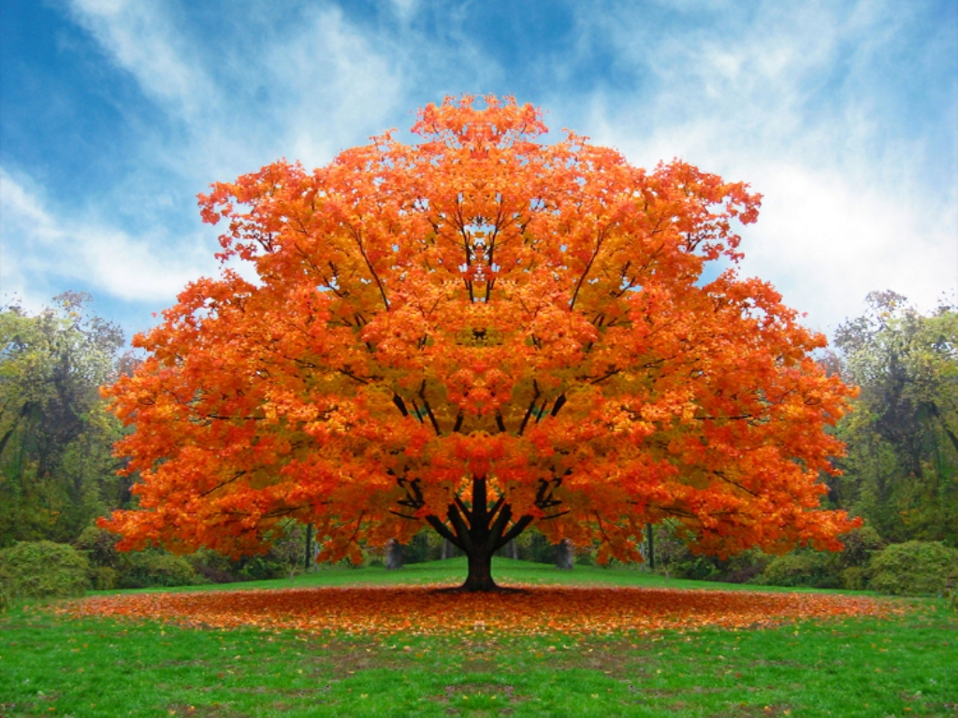
PLANTING
Planting this year is very different and it is much more frequent compared to the other years.
Now Mornico is much greener than before.
At school we did some planting...... we have planted willows and hazels along the banks of the river Zerra.

Slide 9
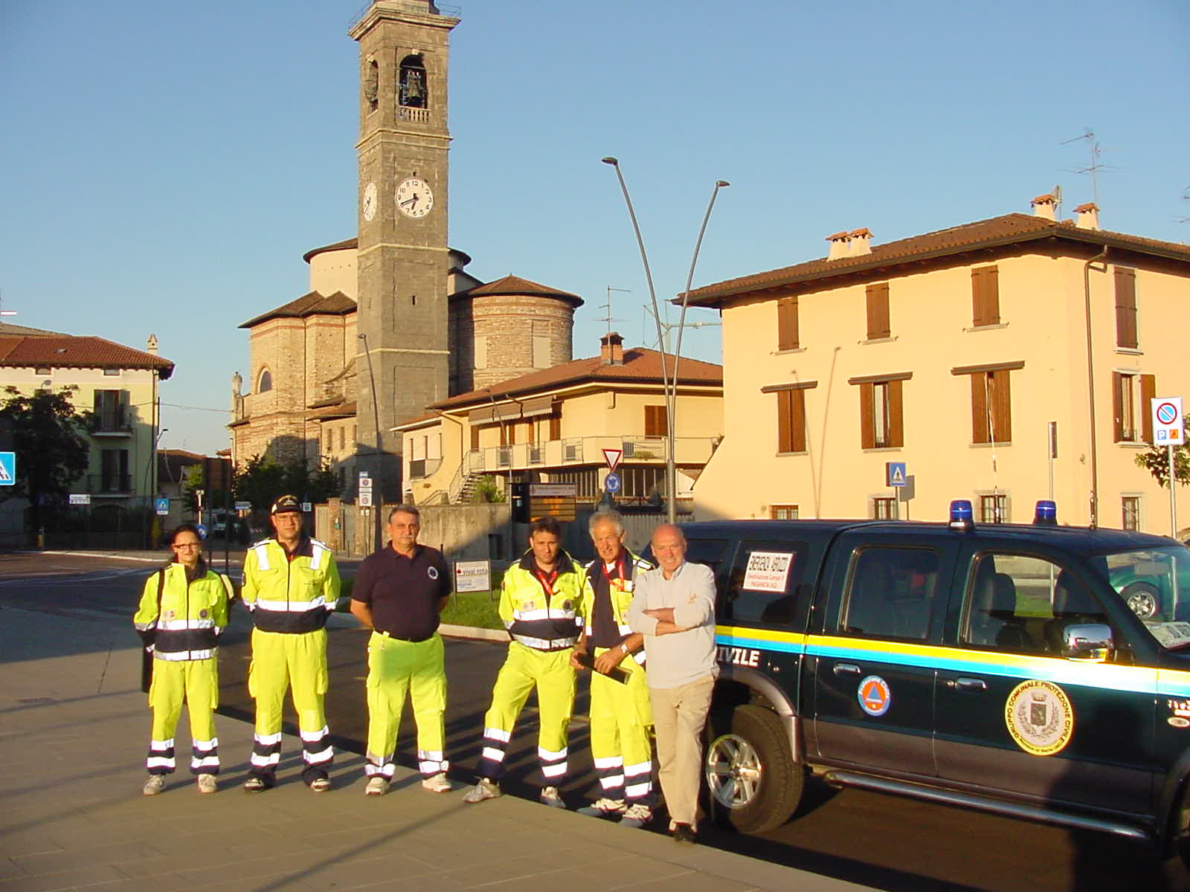
The civil protection
The civil protection is a group of fifteen people that help others when there is snow, floods and other environmental problems.
When there was the earthquake in Aquila the Mornico civil protection went to help these people in serious difficulty.
They wear a phosphorescent uniform to be recognized at night. To help our town they go every year to collect rubbish in the town for the wellness of people.
I’m very happy to have these people because they love this town so much.

Slide 10
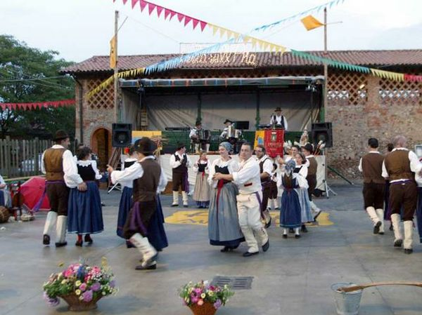
Festa sull’aia
The “festa sull’aia” is a typical festival of the farmer and wants to remember our origins as they have been told in the film “l’albero degli zoccoli”.
Every year a lot of people come to Mornico to eat some of our typical food .
On this feast there are some exhibitions about the farmers and their crops.
It’s another way to enjoy our environment

Slide 11
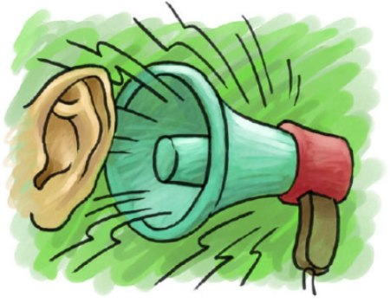
Noise pollution
Noise pollution particularly affects the brain.
The problem of noise pollution is critical in developed countries and it’s caused mainly by traffic.
The noise problems of the past are incomparable with those of modern society.
Today there are important new sources of noise.
Our brains suffer a lot!!!
I try not to make too much noise in my town: it’s nice to be quiet!!!

Slide 12

Reduce the toxic waste
How to reduce toxic waste
Some suggestions are :
1)The reduction of packaging;
2)Sale at promotional prices of cloth diapers for children;
3)Withdrawn unsold food products in supermarkets and distribution, through associations,
4) promoting the sale of organic products;
5)Promotion of utilization the domestic composer in order to reduce organic waste.

Slide 13
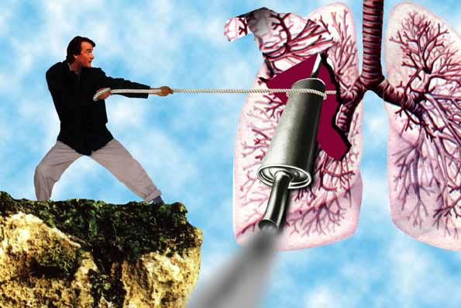
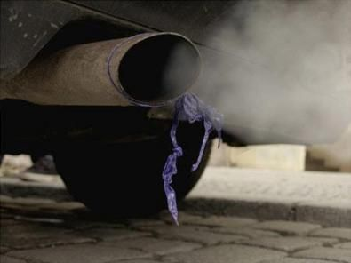
Car pollution
Road traffic is a source of
pollution into the atmosphere.
It puts nitrogen oxides and
other pollutants.
We breathe a terrible air.
This is very dangerous for our lungs
In our little town we try to walk more and more!

Slide 14

What do we do in our town to take care of the planet
Bergamo is a city inserted in the voluntary service of supervision to take care of the environment and manage resources.
We have a special group of people: Guardie ambientali d’Italia
The environmental guard must have the minimum requirements to attend the training courses and pass the exam.
The twelve environmental guards look after the territorial control - control of urban parks and green areas –
They also do activities of environmental education, information and awareness

Slide 15
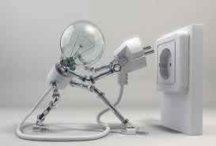
Save the environment in my house
When we buy appliances we start to save electricity, in fact it is important to choose exclusively appliances of classes A, A+ e A++. To choose the right bulb means do not consume too much electricity. Otherwise you risk! An another way to save electricity at home is turn off the lights and also television and decoder.

Slide 16
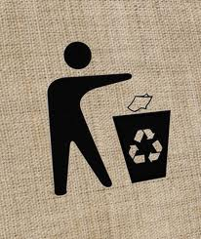
What do we do in our town to take care of the planet?
I live in Bergamo and in my city, to save the environment, we recycle paper, we don’t throw litter on the ground, we don’t waste water and the light because in Bergamo city we like our environment!

Slide 17

Bulbs
Mornico is very clean and we try to save energy.
At Christmas holidays we distribute bulbs with low energy consumption
Bulbs make a lot more light than their voltage

Slide 18
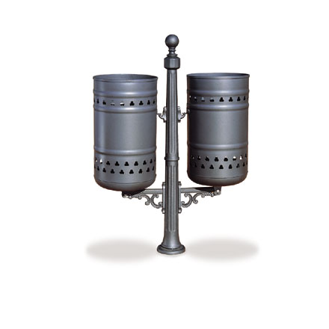
Marti
In my town to keep clean environment we separate rubbish . Every year a special day is organized once a year we go to clean the dirtiest parts of the town.

Slide 19
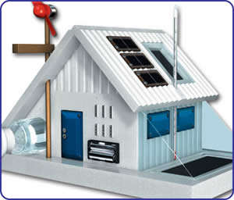
Solar panels
In our town the Town Hall has promoted a new project about the preservation of environment providing free solar panels to families who apply. They save money and they take care of the environment.

Slide 20
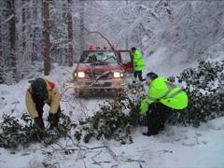
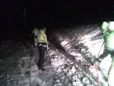
What do we do in our town to take care of the planet?
In Mornico in winter when we need to remove snow from the streets we have the help of civil protection.

Slide 21
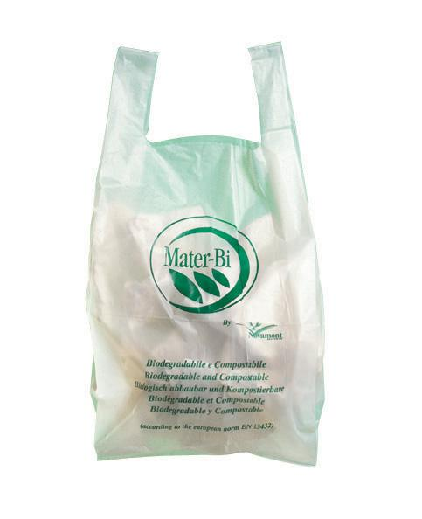
Biodegradable bags
We have replaced plastic bag with biological ones to recycle. Unfortunately we have a problem:
The bag isn’t resistant instead those that are not recyclable are stronger
We use biodegradable bags because the plastic ones take a lot to decompose while the biodegradable bags are made of another material and they decompose faster

Slide 22
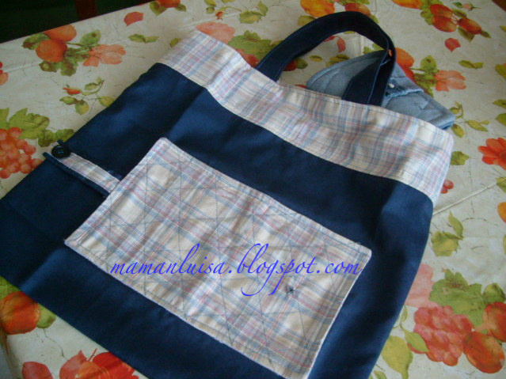
Tote bags
In my country we do some things to keep it clean:
1: The Town hall has distributed special bags to all citizens so that they consume less plastic.
2: there is the civil protection that keeps the streets clean so that at least rubbish is not around the area.

Slide 23
Waiting for your news
Bye
Bye
everybody

